Slide 1
Introduction of IBM Information Server 8.7
Any use, copying or distribution without written permission from UnitedHealth Group is prohibited.

Slide 2
Purpose And Agenda
Purpose
This presentation will provide an overview of Info sphere 8.5/8.7 Architecture that is used by Datastage and other Info sphere tools such as Quality stage, Information analyzer etc.
Agenda
What is IBM InfoSphere Information Server (IIS) 8.5/8.7, its components and the different versions used in UHG?
What is the IBM Infosphere 8.5/8.7 Architecture?
Discussion on InfoSphere 8.5/8.7 Architecture versus previous versions.
What are the different hosts used by Info sphere 8 and how do we interact with datastage using a command line interface?
Question and Answers
Any use, copying or distribution without written permission from UnitedHealth Group is prohibited.

Slide 3
About IBM Info Sphere Information Server 8.7
IBM InfoSphere Information Server – A software platform that cleanses, transforms, and moves information consistently and securely throughout the enterprise
IBM InfoSphere DataStage is a part of IBM Information Server Suit.
IBM InfoSphere Information Server/DataStage follows a client-server architecture
The client components are used for designing, monitoring and administration activities.
IBM InfoSphere Information Server 8.5 is installed in layers that are mapped to the physical hardware. It utilizes the below 4 tiers:
A Tier is a logical group of components within InfoSphere Information Server and the computers on which those components are installed.
  Client Tier
  Service Tier
  Metadata repository Tier
  Engine Tier
Currently we have Information server v8.5 at UHG and plans are to upgrade to version 8.7
Any use, copying or distribution without written permission from UnitedHealth Group is prohibited.

Slide 4
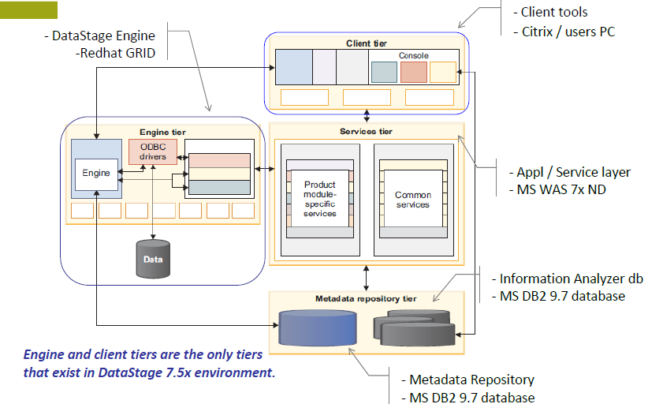
IBM InfoSphere Information Server Architecture
Any use, copying or distribution without written permission from UnitedHealth Group is prohibited.

Slide 5
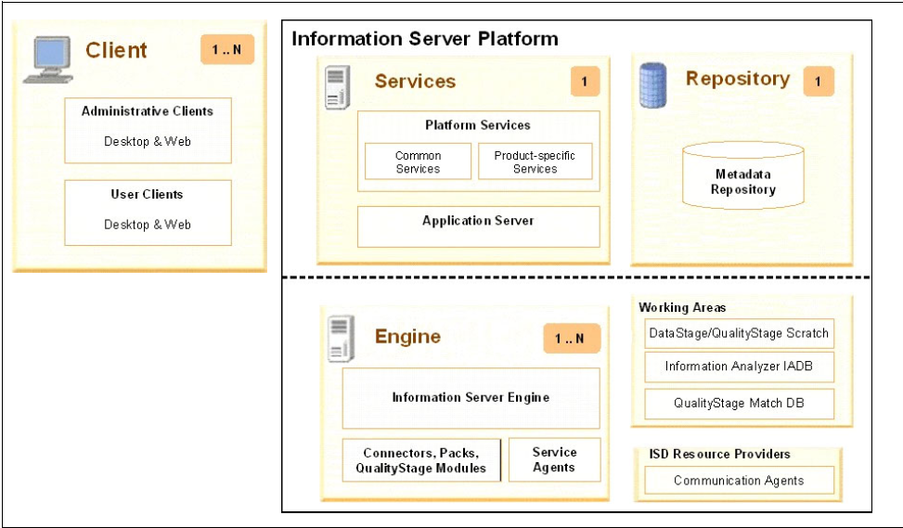

IBM Info Sphere Information Server Architecture Tires
Any use, copying or distribution without written permission from UnitedHealth Group is prohibited.

Slide 6
The four Tiers
Client Tier: This tier consists of product module clients that are not Web-based and that are used for development and administration in IBM InfoSphere Information Server. The clients are Designer, Director and Administrator.
Services Tier: This tier has common (design, metadata & execution) and product-specific services for IBM InfoSphere Information Server.
Metadata repository Tier: This is the database that stores the shared metadata, data, and configuration for IBM InfoSphere Information Server and the product modules.
Engine Tier: This tier has the runtime engine that runs jobs and other tasks for product modules that require the engine.
Any use, copying or distribution without written permission from UnitedHealth Group is prohibited.

Slide 7
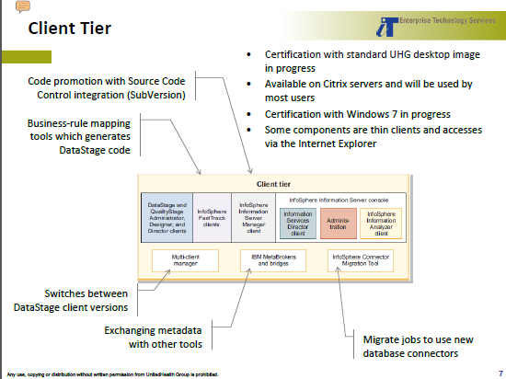
CLIENT TIRE
Any use, copying or distribution without written permission from UnitedHealth Group is prohibited.

Slide 8
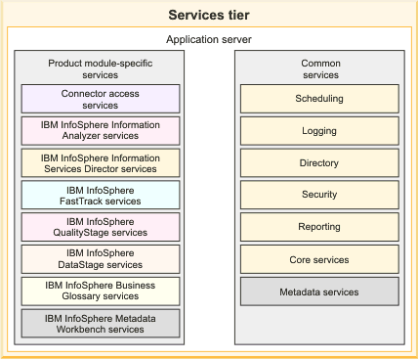
SERVICES TIRE
Any use, copying or distribution without written permission from UnitedHealth Group is prohibited.

Slide 9
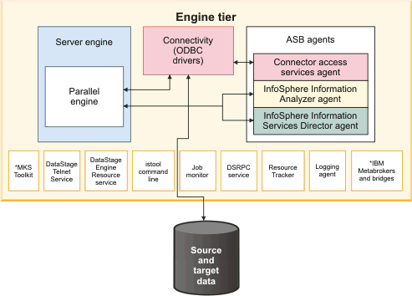
ENGINE TIRE
Any use, copying or distribution without written permission from UnitedHealth Group is prohibited.

Slide 10
ENGINE TIER
The engine tier consists of the logical group of engine components and the computer where those components are installed.Several product modules require the engine tier for certain operations. The following product modules require the engine tier:
IBM InfoSphere DataStage
IBM InfoSphere Information Analyzer
IBM InfoSphere Information Services Director
IBM InfoSphere Metadata Workbench
IBM InfoSphere QualityStage™
IBM InfoSphere Information Server istool command line. The istool framework is installed on the engine tier and client tier. Commands for InfoSphere Information Analyzer and InfoSphere Metadata Workbench are installed on the engine tier only when those products are installed.
Any use, copying or distribution without written permission from UnitedHealth Group is prohibited.

Slide 11
ENGINE TIER
ASB agents : Java processes that run in the background on each computer that hosts an Info Sphere Information Server engine tier. When a service that runs on the services tier receives a service request that requires processing by an engine tier component, the agents receive and convey the request.
ASB agents include:
Connector access services agent : Conveys service requests between the ODBC driver components on the engine tier and the connector access services component on the services tier.
Info Sphere Information Analyzer agent :Conveys service requests between the engine components on the engine tier and the Info Sphere Information Analyzer services component on the services tier.
Info Sphere Information Services Director :agent Conveys service requests between the engine components on the engine tier and the Info Sphere Information Services Director services component on the services tier.
Any use, copying or distribution without written permission from UnitedHealth Group is prohibited.

Slide 12
ENGINE TIER
Logging agent Logs events to the metadata repository.
ODBC drivers :The installation program installs a set of ODBC drivers on the engine tier that works with InfoSphere Information Server components. These drivers provide connectivity to source and target data.
Resource Tracker :The installation program installs the Resource Tracker for parallel jobs with the engine components for InfoSphere DataStage and InfoSphere QualityStage. The Resource Tracker logs the processor, memory, and I/O usage on each computer that runs parallel jobs.
dsrpcd :(DSRPC Service) Allows InfoSphere DataStage clients to connect to the server engine.
Job monitor : A Java application (JobMonApp) that collects processing information from parallel engine jobs. The information is routed to the server controller process for the parallel engine job. The server controller process updates various files in the metadata repository with statistics such as the number of inputs and outputs, the external resources that are accessed, operator start time, and the number of rows processed.
Any use, copying or distribution without written permission from UnitedHealth Group is prohibited.

Slide 13
ENGINE TIER
DataStage engine resource service : Establishes the shared memory structure that is used by server engine processes.
DataStage Telnet service :Allows users to connect to the server engine by using Telnet. Useful for debugging issues with the server engine. Does not need to be started for normal InfoSphere DataStage processing.
MKS Toolkit : Used by the InfoSphere Information Server parallel engine to run jobs.
Any use, copying or distribution without written permission from UnitedHealth Group is prohibited.

Slide 14
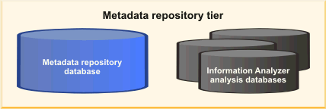
METADATA REPOSITORY
The metadata repository tier includes the metadata repository for IBM InfoSphere Information Server. This database is a shared component that stores design-time, runtime, glossary, and other metadata for product modules in the InfoSphere Information Server suite.
If Info Sphere Information Analyzer is installed, the metadata repository also includes one or more analysis databases. The analysis databases are used by Info Sphere Information Analyzer when it runs analysis jobs
Any use, copying or distribution without written permission from UnitedHealth Group is prohibited.

Slide 15
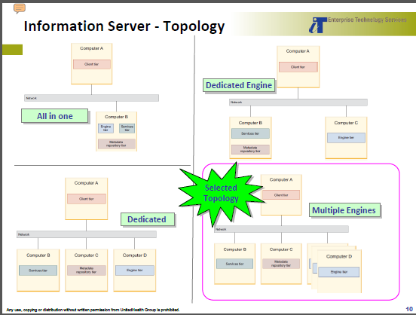
Any use, copying or distribution without written permission from UnitedHealth Group is prohibited.

Slide 16
Benefits of IBM Information Server
Integrated DataStage and QualityStage in same job designs
Greater scalability for jobs with large datasets with GRID architecture
Maximized utilization of available resources with sharing of computing servers
Dynamic reallocation of computing resources based on demand
Resource estimation and performance analysis to predict and validate runtime resource requirements
Faster project provisioning and better storage utilization due to shared storage model
Improved and consolidated connectivity options for common databases including Oracle, DB2, Teradata and SQL Server (ODBC)
WebSphere MQ queues can be used for sources / target data sources
Enhanced developers’ productivity with many new improvements in the client tools
Improved metadata management
Any use, copying or distribution without written permission from UnitedHealth Group is prohibited.

Slide 17
Info Sphere Information Server unified platform components
Any use, copying or distribution without written permission from UnitedHealth Group is prohibited.

Slide 18
DATASTAGE HISTORY
DataStage was conceived at VMark, a spin off from Prime Computers that developed two notable products: UniVerse database and the DataStage ETL tool. The first VMark ETL prototype was built by Lee Scheffler in the first half of 1996
VMark acquired UniData in October of 1997 and renamed itself to Ardent Software. In 1999 Ardent Software was acquired by Informix the database software vendor.
In April of 2001 IBM acquired Informix and took just the database business leaving the data integration tools to be spun off as an independent software company called Ascential Software.
In March of 2005 IBM acquired Ascential Software and made DataStage part of the WebSphere family as WebSphere DataStage. In 2006 the product was released as part of the IBM Information Server under the Information Management family but was still known as WebSphere DataStage.
In 2008 the suite was renamed to InfoSphere Information Server and the product was renamed to InfoSphere DataStage.
IBM Information Server Version 8.7 Released on October 2011
IBM Information Server, Version 9.1. Released on November 2012
Any use, copying or distribution without written permission from UnitedHealth Group is prohibited.

Slide 19
InfoSphere Information Server Version 8.7 Components
IBM InfoSphere DataStage
IBM InfoSphere QualityStage
IBM InfoSphere Information Analyzer
IBM InfoSphere FastTrack
IBM InfoSphere Metadata Workbench
IBM InfoSphere Business Glossary
IBM InfoSphere Information Services Director
IBM InfoSphere Blueprint Director
Any use, copying or distribution without written permission from UnitedHealth Group is prohibited.

Slide 20
InfoSphere DataStage V8.7
Data stage is one of the GUI based ETL tool which is used to create usable data warehouse and data mart applications.
Data stage has multiple jobs
1.server jobs
2.parallel jobs
3.Mainframe Jobs
4.Sequencer Jobs
Any use, copying or distribution without written permission from UnitedHealth Group is prohibited.

Slide 21
What is IBM Info Sphere Quality Stage
IBM Info sphere Quality Stage is a tool intended to deliver high quality data required for success in a range of enterprise initiatives including business intelligence, legacy consolidation and master data management.
It does this primarily by identifying components of data that may be in columns or free format, standardizing the values and formats of those data,using the standardized results and other generated values to determine likely duplicate records, and building a “best of breed” record out of these sets of potential duplicates

Slide 22
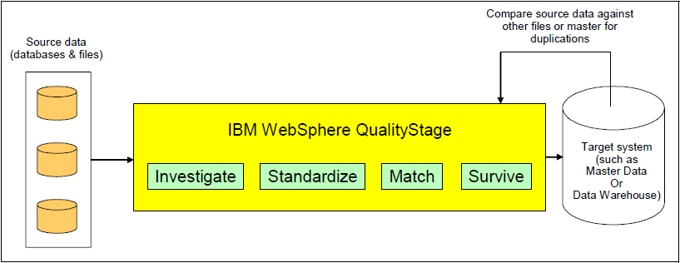
QUALITYSTAGE PROCESS OVERVIEW

Slide 23

Info sphere Quality Stage Typical Scenario
Multiple databases and files
Compare source data against other files or master for duplications
Compare
Master Data
or
Data Warehouse
Info sphere Quality Stage
Load unique data and discard duplicates
Source data
Notes:
IBM Confidential

Slide 24
Data Quality Challenges
Different or inconsistent standards in structure, format or values
Missing data, default values
Spelling errors, data in wrong fields
Buried information
Data myopia
Data anomalies

Slide 25
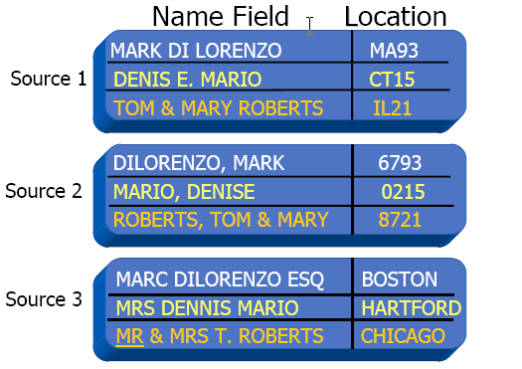
Different or Inconsistent Standards

Slide 26
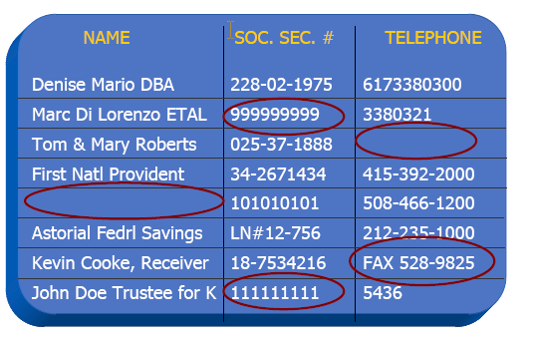
Missing Data & Default Values

Slide 27
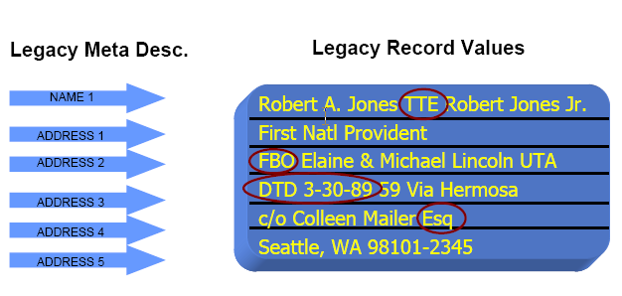
Buried Information

Slide 28
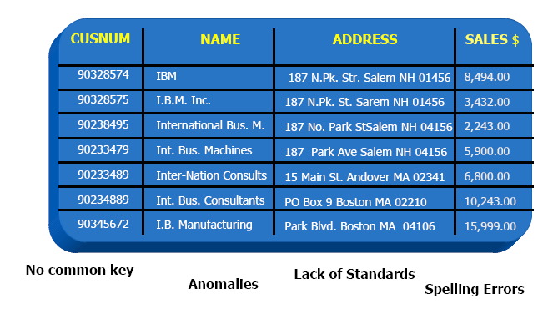
The Anomalies Nightmare

Slide 29
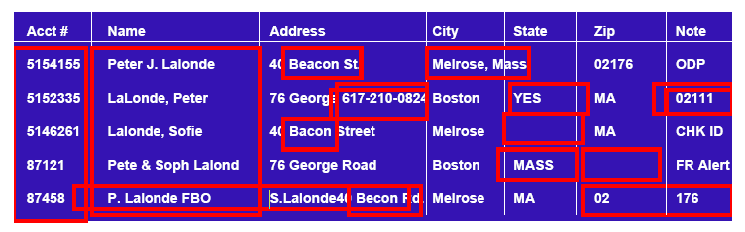
What data challenges do you face?

Slide 30
QualityStage Basics
Ascential QualityStage helps you manage and maintain data quality
so that your company can rely upon its corporate data investment.
Helps organizations produce high-quality data as well as lower the
cost of data management.
IBM Quality Stage is a comprehensive development environment for developing applications that re-engineer data.
The aim of such an application is to deliver data that meets business requirements and successfully addresses business goals.
Data that is restructured to meet the new requirements is called re-engineered data.
Notes:
IBM Confidential
A re-engineering application caters to the following
Resolve conflicting and ambiguous meaning of data values.
Brings to surface important data hidden in free form text fields.
Standardizes data conforming to industry standards and government standards.
Creates a a unique view of a business unity.

Slide 31
QUALITYSTAGE STAGES
INVESTIGATE STAGE
STANDARDIZE STAGE
MNS STAGE
WAVES STAGE
AVI STAGE
MATCH FREQUENCY STAGE
UNDUPLICATE STAGE
REFERENCE MATCH STAGE
STANDARDIZE QUALITY ASSESMENT
SURVIVE STAGE
Any use, copying or distribution without written permission from UnitedHealth Group is prohibited.

Slide 32
IBM Info Sphere Information Analyzer
Data Profiling
You use data profiling and analysis to understand your data and ensure that it suits the integration task. Information Analyzer is a critical component of IBM Info Sphere Information Server that profiles and analyzes data so that you can deliver trusted information to your users.
Info Sphere Information Analyzer can automatically scan samples of your data to determine their quality and structure. This analysis aids you in understanding the inputs to your integration process, ranging from individual fields to high-level data entities. Information analysis also enables you to correct problems with structure or validity before they affect your project.
Any use, copying or distribution without written permission from UnitedHealth Group is prohibited.

Slide 33
IBM Info Sphere Information Analyzer
In many situations, analysis must address data, values, and rules that are best understood by business users. Particularly for comprehensive enterprise resource planning, customer relationship management, or supply chain management packages, validating data against this business knowledge is a critical step. The business knowledge, in turn, forms the basis for ongoing monitoring and auditing of data to ensure validity, accuracy, and compliance with internal standards and industry regulations.
While analysis of source data is a critical first step in any integration project, you must continually monitor the quality of the data. Info Sphere Information Analyzer enables you to treat profiling and analysis as an ongoing process and create business metrics that you can run and track over time.
Any use, copying or distribution without written permission from UnitedHealth Group is prohibited.

Slide 34
Information Analyzer Investigation Functionalities
Column Analysis
Primary Key Analysis
Foreign Key Analysis
Cross Domain Analysis
Publish Analysis Results
Baseline Analysis
Reports
Any use, copying or distribution without written permission from UnitedHealth Group is prohibited.

Slide 35
IBM Info Sphere Fast track
IBM Info Sphere Fast Track automates multiple data integration tasks from analysis to code generation, while incorporating the business perspective and maintaining lineage and documented requirements. Info Sphere Fast Track accelerates the design time to create source-to-target mappings and to automatically generate jobs. Mappings and jobs are then integrated into the metadata repository for IBM InfoSphere Information Server.
Any use, copying or distribution without written permission from UnitedHealth Group is prohibited.

Slide 36
IBM InfoSphere Metadata Workbench
IBM InfoSphere Metadata Workbench provides a visual, Web-based exploration of metadata that is generated, used, and imported by IBM InfoSphere Information Server.
InfoSphere Information Server components store design time, runtime, and glossary metadata in the metadata repository. Users can also import database and data file information into the metadata repository and create extended data sources and extension mappings that represent objects and processes that exist outside of InfoSphere Information Server.
InfoSphere Metadata Workbench helps business and IT users explore and manage those metadata assets. The metadata workbench gives you reports on data flow, data lineage, and the impact of changes to data assets or physical assets.
Any use, copying or distribution without written permission from UnitedHealth Group is prohibited.

Slide 37
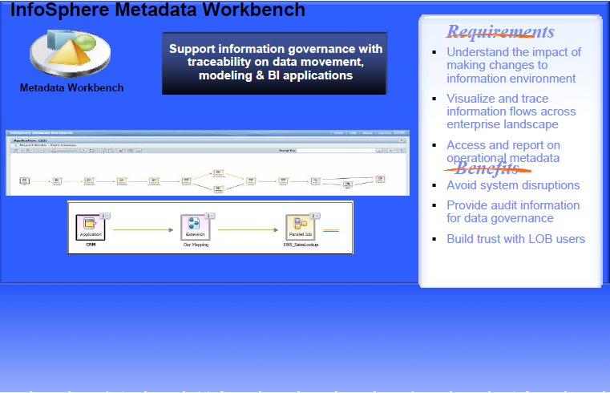
IBM InfoSphere Metadata Workbench
Any use, copying or distribution without written permission from UnitedHealth Group is prohibited.

Slide 38
InfoSphere Business Glossary
IBM InfoSphere Business Glossary is an interactive, Web-based tool that enables users to create, manage, and share an enterprise vocabulary and classification system. A business glossary is designed to help users understand business language and the business meaning of information assets like databases, jobs, database tables and columns, and business intelligence reports. In addition to categories and terms, the business glossary also contains information about other assets such as database tables, jobs, and reports that are in the metadata repository.
Any use, copying or distribution without written permission from UnitedHealth Group is prohibited.

Slide 39
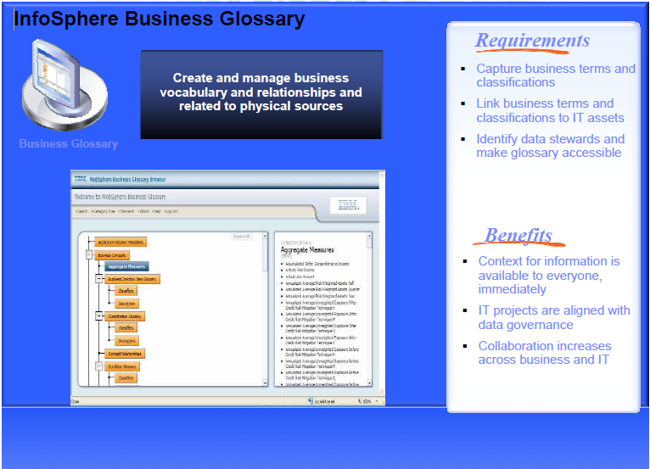
InfoSphere Business Glossary
Any use, copying or distribution without written permission from UnitedHealth Group is prohibited.

Slide 40
IBM InfoSphere Information Services Director
IBM InfoSphere Information Services Director provides a unified and consistent way to publish and manage shared information services. Using InfoSphere Information Services Director, information specialists can design and deploy reusable information integration tasks including data cleansing, data transformation, and data federation services.
You can more easily create business processes with information from a complex, heterogeneous environment if that information is published as consistent and reusable services.
Any use, copying or distribution without written permission from UnitedHealth Group is prohibited.

Slide 41
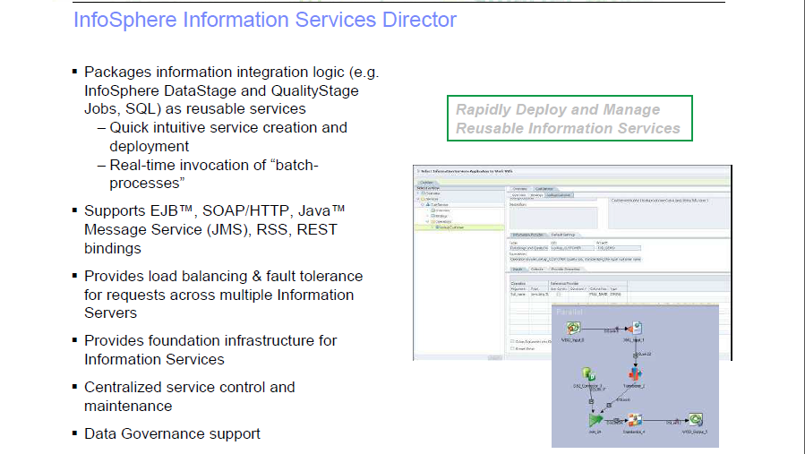
Any use, copying or distribution without written permission from UnitedHealth Group is prohibited.

